Slide 1
Shell metacharacters
The command options, option arguments and command arguments are separated by the space character. However, we can also use special characters called metacharacters.
Linux uses special characters or symbols known as metacharacters that add special meaning to a shell command with respect to file search and commands connection.
File Matching Metacharacters

Slide 2
Symbol | Meaning
> | Output redirection
>> | Output redirection (append)
< | Input redirection
* | File substitution wildcard; zero or more characters
? | File substitution wildcard; one character
[ ] | File substitution wildcard; any character between brackets
`cmd` | Command Substitution
$(cmd) | Command Substitution
| | The Pipe (|)
; | Command sequence, Sequences of Commands
[ ] | File substitution wildcard; any character between brackets
|| | OR conditional execution
&& | AND conditional execution
( ) | Group commands, Sequences of Commands
& | Run command in the background, Background Processes
# | Comment
$ | Expand the value of a variable
\ | Prevent or escape interpretation of the next character
<< | Input redirection

Slide 3

ls c* Output: catfish.sh cat.txt cider.sh
ls c*h
ls *r*
ls a?*
ls c?t*
ls [av]*
ls [ac]*[t]
ls [a-j]*

Slide 4
The tput command
tput command is used to query the terminfo terminal database and check if that terminal supports a specific feature.
tput command accepts the terminal commands and output the control code sequences for that terminal. Using tput you can control the color and cursor of your terminal
Set the Cursor Position using tput cup
You can move the cursor to a specific row and column using tput cup. Following example positions the cursor at row 2 and column 3.
$ tput cup 2 3
Clear the Screen Using tput clear
If you are in middle of the terminal screen, tput clear will clear the screen and put you at the top of the terminal screen.
$ tput clear

Slide 5
Get the Number of Columns and Lines of a Terminal
To display the number of columns of your terminal screen, do the following.
$ tput cols
Following displays number of lines of your terminal screen.
$ tput lines
Execute Multiple tput Commands
tput allows you to run set of commands in a single time. For example, if you want to clear the screen and set cursor to a particular position,
$ tput -S <<END
> clear
> cup 2 4
> END

Slide 6
Change the Terminal Background Color using tput setb
Using tput, the background color of the screen can be changed as shown below.
$ tput setb 4
Change the Foreground Color using tput setf
You can also change the foreground color of the terminal as shown below.
$ tput setf 4
If you set foreground and background to the same color you cannot see the cursor. So, to reset, execute “tput reset”.

Slide 7
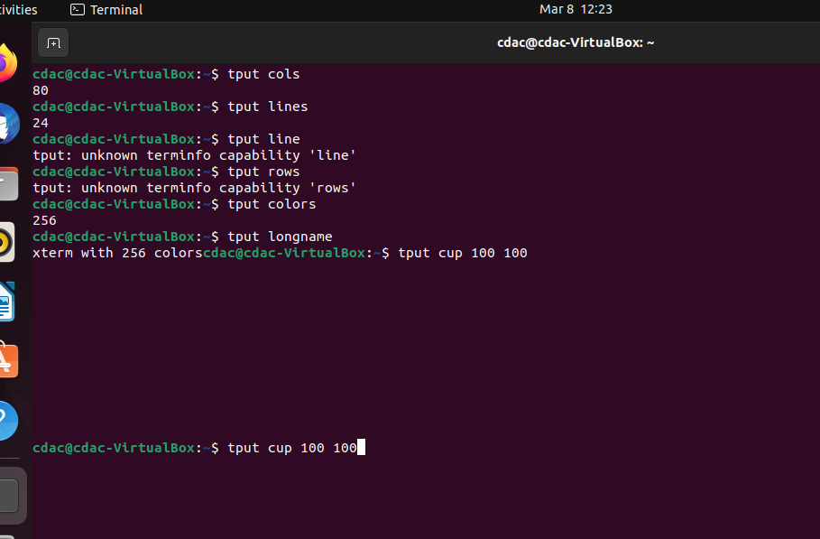

Slide 8
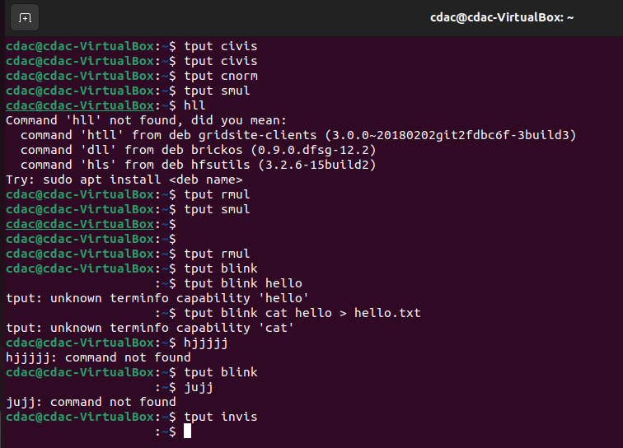

Slide 9
Understanding systemctl vs. service
There are two official management tools that provide a consistent way to start, stop, restart and manage system services in Linux:
systemctl
Service
for starting, stopping or restarting applications on Linux, best practices begin and end with systemctl

Slide 10
sudo systemctl start apache2
sudo systemctl status apache2
sudo systemctl stop apache2
sudo systemctl restart apache2
List all services
service --status-all
Use Systemd to Start/Stop/Restart Services in Ubuntu
The Syntax is:
sudo systemctl [action] [service name]

Slide 11
sudo systemctl stop ufw
Start/Stop/Restart Services with service command on Ubuntu
You can start, stop, or restart services using the service command too. Open up a terminal window, and enter the following commands.
To start a service:
sudo service ufw stop
To stop a service:
sudo service ufw start
sudo service ufw restart
To check the status of a service:
sudo service ufw status

Slide 12
What is Git?
Git is a Version Control System (VCS) designed to make it easier to have multiple versions of a code base, sometimes across multiple developers or teams
It allows you to see changes you make to your code and easily revert them
what is Github?
Github.com is a website that hosts git repositories on a remote server
Hosting repositories on Github facilitates the sharing of codebases among teams by providing a GUI to easily fork or clone repos to a local machine
By pushing your repositories to Github, you will pretty much automatically create your own developer portfolio as well!

